Slide 1
Appropriate use of Antibiotics;
The health care worker’s role
Dr, Nyawira Gitahi-Kamau
GSK Infectious disease medical advisor Kenya

Slide 2
Antibiotic stewardship
Antimicrobial stewardship refers to coordinated interventions designed to improve and measure the appropriate use of antimicrobials by promoting the selection of the optimal antimicrobial drug regimen, dose, duration of therapy, and route of administration.
https://www.idsociety.org/Stewardship_Policy/

Slide 3
WHY ANTIBIOTIC STEWARDSHIP?

Slide 4
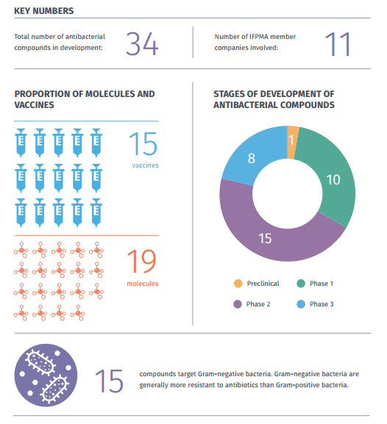
Global AMR Pipeline
IFPMA membership pipeline inventory in 2015
R&D investment underway
But more to be done…
Rethinking the way we fight bacteria, IFPMA report, 2015. Available at:
http://www.ifpma.org/wp-content/uploads/2016/02/IFPMA_Rethinking_the_way_we_fight_bacteria_April2015_FINAL.pdf
Accessed on 24/04/2016

Slide 5
ANTIBIOTIC STEWARDSHIP

Slide 6
AREAS ADDRESSED IN IMPLEMENTING ANTIBIOTIC STEWARDSHIP
Stop and re-evaluate treatment with diagnostic feedback/additional history
All antibiotic prescriptions should have 3 pieces of information -- a dose, duration, and indication.
When prescribing, make certain that they include choices made with diagnostics
Look at matrices that will indicate success /progress of program. Evidence speaks!!
Treatment protocol/guidelines based on expected /known sensitivities

Slide 7
ANTIBIOTIC STEWARDSHIP
http://bsac.org.uk/wp-content/uploads/2013/07/Stewardship-Booklet-Practical-Guide-to-Antimicrobial-Stewardship-in-Hospitals.pdf

Slide 8
Antibiotic stewardship

Slide 9
High recommendation for outcome measures and evaluation

Slide 10
High recommendation for outcome measures and evaluation
Compliance to hospital formulary /guideline
T-sheet renewal and review rate
Re-admissions with HAI after admissions

