Slide 1
Update: Antimicrobial Resistance and Global Health Security Agenda
Daniel VanderEnde
Medical Officer, Division of Healthcare Quality Promotion
Centers for Disease Control and Prevention
IPNET -Kenya
November 16, 2016
National Center for Emerging and Zoonotic Infectious Diseases
Division Name in this space

Slide 2
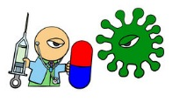
What is Antimicrobial Resistance (AMR)?
Throughout history there has been a
continual battle between humans and the
multitude of harmful germs that cause
infection and disease
AMR is the ability of harmful germs that cause disease to survive attack by antimicrobials (antibiotics)
The ability of germs to survive is called Antibiotic Resistance
Antibiotics are losing their effectiveness to fight disease because of antimicrobial resistance

Slide 3
What is Antimicrobial Resistance (AMR)?
Antimicrobial resistance happens when microorganisms (such as bacteria, fungi, viruses, and parasites) change when they are exposed to antimicrobial drugs (such as antibiotics, antifungals, antivirals, antimalarials, and anthelmintics).
As a result, the medicines become ineffective and infections persist in the body, increasing the risk of spread to others.

Slide 4
How AMR Spreads

Slide 5
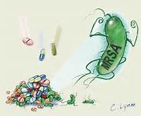
Why AMR is a Concern
Resistant germs can affect
anyone as they may spread to
other patients, family members
and to the community
AMR can lead to:
Treatment failure
Prolonged hospital stay
Increased treatment costs
Increased mortality
There is a threat that we may return to a time when there were no antibiotics
Example:
Methicillin-resistant Staphylococcus aureus (MRSA)

Slide 6
Antimicrobial Resistance
“Imminent crisis in the control of infectious diseases”
IOM report, 2003 Microbial Threats to Health: Emergence, Detection, and Response
“…One of the world's most pressing public health problems”
Joint Statement on Antibiotic Resistance from 25 National Health Organizations and the CDC, 2012
Antibiotic resistance is among CDC's top concerns
Notes:
The problem is of global concern and is creating dilemmas for the treatment of infections in both hospitals and community health care settings. Moreover, as noted above, the pharmaceutical industry is developing fewer new antimicrobials than in previous years. Therefore, immediate action must be taken to preserve the effectiveness of available drugs by reducing the inappropriate use of antimicrobials in human and animal medicine.

Slide 7
AMR Requires Global Action

Slide 8
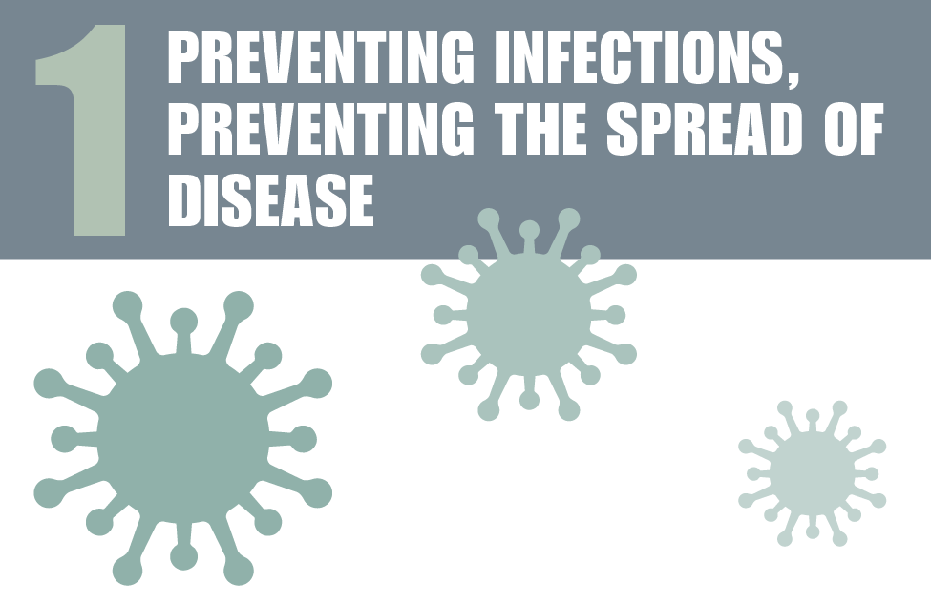
Fighting back against
antibiotic resistance

Slide 9
AR Prevention and Control in Low Resource Settings
Policies should be realistic and enforceable
Implement Horizontal and Vertical programs
Build lab capacity
Facilitate outbreak investigations
Practice Antimicrobial Stewardship

Slide 10
Overall Goal
Right drug
Right dose
Right duration
Recognize when not needed
Notes:
Every patient receives
The right drug(s)
At the right time
At the right dose
For the right duration

Slide 11
Fighting back against
antibiotic resistance

Slide 12
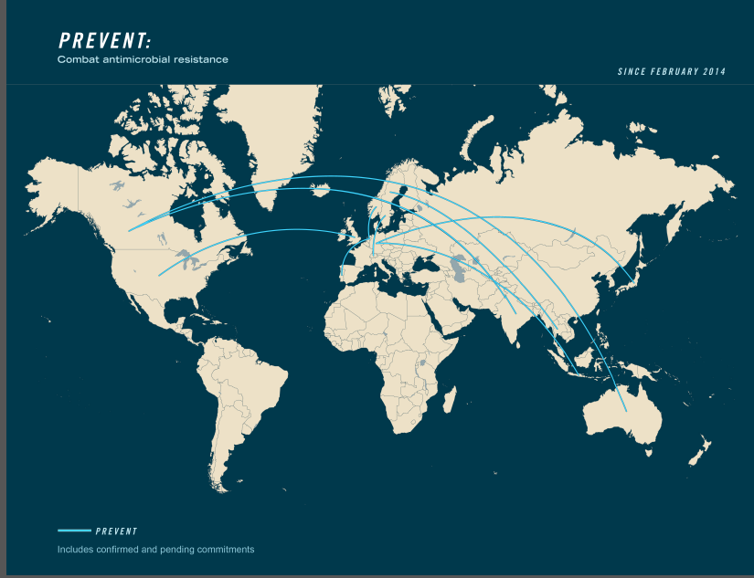
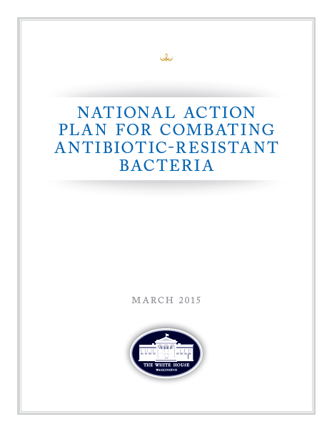
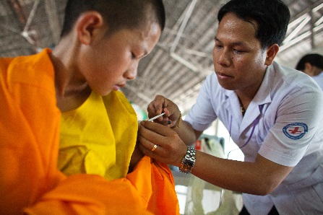
Tackling Antimicrobial Resistance on Many Fronts
Foundational capacities
Country ownership and national commitments
Healthcare provider buy-in; link to infection control and prevention
YOU
Patient awareness
Global priorities & objectives
Technical expertise

Slide 13
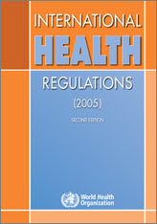
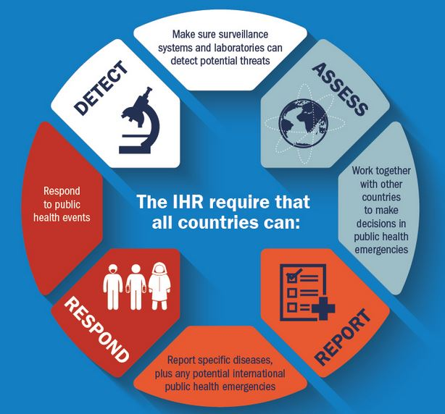
International Health Regulations (2005)
Notes:
Because of the many ways in which we are connected, no country can protect itself, by itself. This lesson became especially clear during the SARS outbreak in 2003. To address the shortcomings of the global response to SARS, WHO revised the IHR in 2005 to better control public health threats while avoiding unnecessary interference with international travel and trade.
At the World Health Assembly in 2005, all UN member states committed to achieving the goals of the revised International Health Regulations over a five year period.
The IHR require that all countries have the ability to:
Make sure surveillance systems and laboratories can detect potential threats
Work together with other countries to make decisions in public health emergencies
Report transparently through participation in a network of National Focal Points
Respond to public health events. WHO also has the authority and responsibility to declare the highest level of health threats, called a Public Health Emergency of International Concern (PHEIC)
In fact, IHR can be summed up in 4 words: Detect, Assess, Report, Respond

Slide 14
Less than 1/3 of the world is prepared to respond
All 194 countries of the world committed to International Health Regulations in 2005
By 2014, only 30% of countries were fully prepared to detect and respond to an outbreak
Source: Report to the Director-General of the Review Committee on Second Extensions for Establishing National Public Health Capacities and on IHR Implementation, November 2014

Slide 15
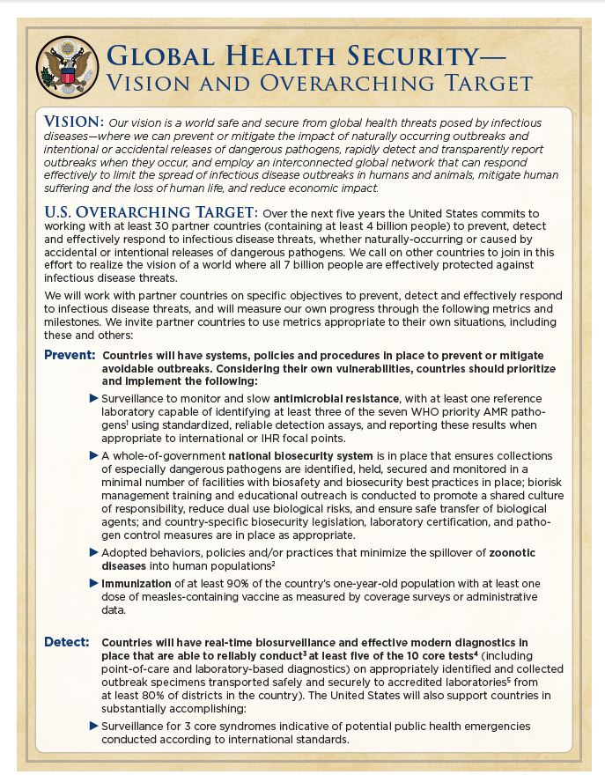
The Global Health Security Agenda
A unifying framework to improve our global response to disease outbreaks
Notes:
The truth is that we need practical steps we can take to assist all countries to reach the IHR goals, which brings us to the Global Health Security Agenda, a unifying framework to improve our global response to disease outbreaks.

Slide 16
Shared Priorities: GHSA and IHR
GHSA
Surveillance
Laboratory
Preparedness
Response
Zoonotic disease
Human resources
IHR
Notes:
When aligned with IHR, most of the ideas behind GHSA are not new; we are building on agreements and commitments countries have already made.
GHSA was developed to advance IHR, by providing a path with clear targets and milestones to strengthen core capacities and achieve IHR compliance. GHSA will help us move forward and help us achieve the goal of IHR, a goal of a world safe and secure from the threat on infectious diseases.

Slide 17
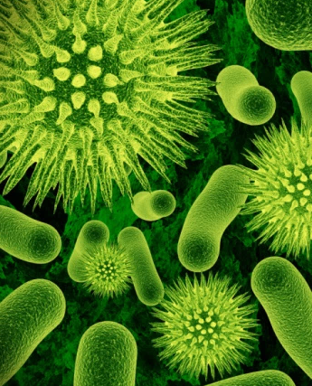
3
3
3
Risks
Opportunities
Priorities
Emerging organisms
Drug resistance
Intentional creation
Societal commitment
New technologies
Success leads to success
Prevent wherever possible
Detect rapidly
Respond effectively

Slide 18
A Global Initiative
Vision: A world safe and secure from global health threats posed by infectious diseases…
GHSA launched in February 2014 with leaders from 28 countries, WHO, OIE and FAO
By September 26, 2014: 44 countries joined the GHSA
June 2015, G7 committed to assist at least 60+ countries
September 2015, second GHSA Ministerial meeting held in Seoul, South Korea
Notes:
On February 13, 2014, leaders from 28 Ministries of Health, the World Health Organization (WHO), the Food and Agricultural Organization (FAO), and the World Organization for Animal Health (OIE) came together to launch the Global Health Security Agenda. The vision of the agenda is to realize a world safe and secure from global health threats posed by infectious diseases.
At the time of the launch, Ebola was spreading undetected from Guinea to Liberia and Sierra Leone. By the fall of 2014, Ebola had galvanized the international community around the Agenda.
At the first GHSA Ministerial meeting in September, which was convened in Washington and attended by President Obama, 44 countries joined the agenda. Nine months later, the seven nations of the world’s largest economies, the G7, pledged to help up to 60 countries achieve the GHSA targets.

Slide 19
Notes:
By now, 50 countries have committed to GHSA.

Slide 20
Global Health Security Agenda
Prevent avoidable
catastrophes
Detect threats early
Respond rapidly and effectively
Notes:
GHSA provides us with a set of concrete and achievable actions to reach that common vision and to help reach public health goals through eleven targets that aim to
PREVENT avoidable catastrophes,
DETECT threats early, and
RESPOND rapidly and effectively. All of the different aspects of GHSA further these three simple goals.

Slide 21
Action Packages to Achieve Targets
Antimicrobial Resistance
National Laboratory Systems
Emergency Operations Centers
Zoonotic Diseases
Surveillance
Linking Public Health with Law Enforcement and Multisectoral Rapid Response
Biosafety/Biosecurity
Reporting
Medical Countermeasures and Personnel Deployment
Immunization
Workforce Development
Notes:
There are eleven action packages, or targets, that comprise GHSA. While they may seem like discrete activities, these lanes are overlapping and inter-related.
As an example, the Antimicrobial Resistance technical area aims to prevent the emergence and spread of antimicrobial-resistant organisms, increase the surveillance and early detection of antimicrobial-resistant organisms, and enhancing antimicrobial stewardship to include promoting the appropriate and responsible use of antibiotics in all settings.
To meet the objectives for AMR, public health officials and SMEs will have to combine efforts with surveillance programs, laboratory programs and systems, information systems and other sectors to achieve these goals

Slide 22
Leading and Contributing
Prevent avoidable
catastrophes
Leading | Contributing
Canada Germany Netherlands Sweden | Australia India Indonesia Italy Japan Norway Portugal Switzerland Thailand United States
Antimicrobial Resistance

Slide 23
GHSA Antimicrobial Resistance Action Package
Five-Year Target:
Develop an integrated and global package of activities to combat antimicrobial resistance, including:
Each country has its own national comprehensive plan

Slide 24
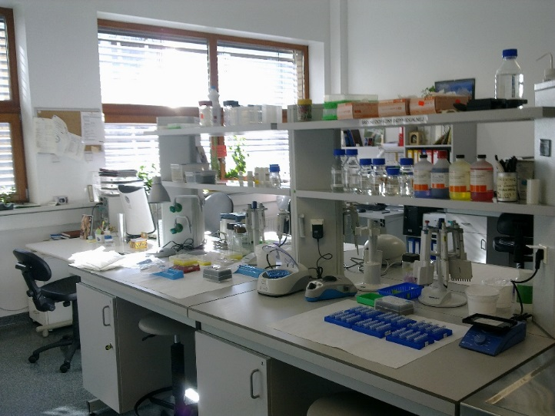
GHSA Antimicrobial Resistance Action Package
Five-Year Target:
Develop an integrated and global package of activities to combat antimicrobial resistance, including:
Each country has its own national comprehensive plan
Strengthen surveillance and laboratory capacity at the national and international level

Slide 25
GHSA Antimicrobial Resistance Action Package
Five-Year Target:
Develop an integrated and global package of activities to combat antimicrobial resistance, including:
Each country has its own national comprehensive plan
Strengthen surveillance and laboratory capacity at the national and international level
Improved conservation of existing treatments and collaboration to support the sustainable development of new antibiotics, alternative treatments, preventive measures and rapid, point-of-care diagnostics, including systems to preserve new antibiotics

Slide 26
GHSA Antimicrobial Resistance Action Package
Desired National Impact:
Notes:
Desired National Impact:
Decisive and comprehensive action to enhance infection prevention and control activities to prevent the emergence and spread of AMR, especially among drug-resistant bacteria. Nations will strengthen surveillance and laboratory capacity, ensure uninterrupted access to essential antibiotics of assured quality, regulate and promote the rational use of antibiotics in human medicine and in animal husbandry and other fields as appropriate, and support existing initiatives to foster innovations in science and technology for the development of new antimicrobial agents.

Slide 27
GHSA Antimicrobial Resistance Action Package
Desired National Impact:
Enhance infection prevention and control activities
Notes:
Desired National Impact:
Decisive and comprehensive action to enhance infection prevention and control activities to prevent the emergence and spread of AMR, especially among drug-resistant bacteria. Nations will strengthen surveillance and laboratory capacity, ensure uninterrupted access to essential antibiotics of assured quality, regulate and promote the rational use of antibiotics in human medicine and in animal husbandry and other fields as appropriate, and support existing initiatives to foster innovations in science and technology for the development of new antimicrobial agents.

Slide 28
GHSA Antimicrobial Resistance Action Package
Desired National Impact:
Enhance infection prevention and control activities
Strengthen surveillance and laboratory capacity
Notes:
Desired National Impact:
Decisive and comprehensive action to enhance infection prevention and control activities to prevent the emergence and spread of AMR, especially among drug-resistant bacteria. Nations will strengthen surveillance and laboratory capacity, ensure uninterrupted access to essential antibiotics of assured quality, regulate and promote the rational use of antibiotics in human medicine and in animal husbandry and other fields as appropriate, and support existing initiatives to foster innovations in science and technology for the development of new antimicrobial agents.

Slide 29
GHSA Antimicrobial Resistance Action Package
Desired National Impact:
Enhance infection prevention and control activities
Strengthen surveillance and laboratory capacity
Access to essential antibiotics of assured quality
Regulate and promote the rational use of antibiotics
Notes:
Desired National Impact:
Decisive and comprehensive action to enhance infection prevention and control activities to prevent the emergence and spread of AMR, especially among drug-resistant bacteria. Nations will strengthen surveillance and laboratory capacity, ensure uninterrupted access to essential antibiotics of assured quality, regulate and promote the rational use of antibiotics in human medicine and in animal husbandry and other fields as appropriate, and support existing initiatives to foster innovations in science and technology for the development of new antimicrobial agents.

Slide 30
GHSA Antimicrobial Resistance Action Package
Desired National Impact:
Enhance infection prevention and control activities
Strengthen surveillance and laboratory capacity
Access to essential antibiotics of assured quality
Regulate and promote the rational use of antibiotics
Support existing initiatives to foster innovations
Notes:
Desired National Impact:
Decisive and comprehensive action to enhance infection prevention and control activities to prevent the emergence and spread of AMR, especially among drug-resistant bacteria. Nations will strengthen surveillance and laboratory capacity, ensure uninterrupted access to essential antibiotics of assured quality, regulate and promote the rational use of antibiotics in human medicine and in animal husbandry and other fields as appropriate, and support existing initiatives to foster innovations in science and technology for the development of new antimicrobial agents.

Slide 31
Harmonization of GHSA and IHR assessments into the Joint External Evaluation Tool

Slide 32
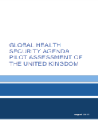
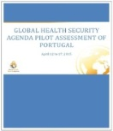
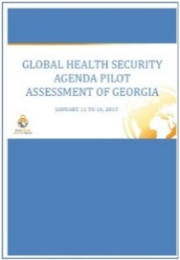
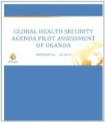
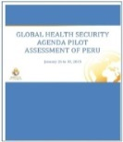
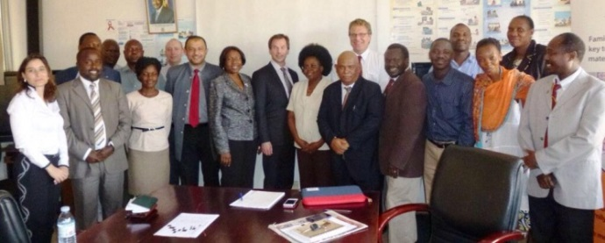
Objectives of GHSA country assessments
Provide a scalable, independent and transparent assessment process
Compile information with value to country, development partners and funders
Foster true cross-sector – ‘One Health’ cooperation and self-examination
A joint external objective assessment by peers the results of which are publicly available to all partners
Enable country and partners to identify gaps and development needs and build an implementation plan for the closing of the gaps
https://stm.fi/en/international-cooperation/ghsa
https://ghsagenda.org/assessments.html

Slide 33
Joint External Evaluation Process
Targets guide the country capacity assessment and inform country action plans and partner commitments to improve health security
Combined GHSA & IHR Targets and Indicators guide the Host Country Self Assessment which is validated by an External Assessment Team. These results are publicly disseminated.
Text
Partner
Commitments & Country Investments
Country
Assessments
Improved Health Security Capability
Based on the Assessment and Country Action Plan, partners support country investments in achieving Targets through funding, training, infrastructure, and technical assistance.
Based on Assessment results, countries develop specific action plans to meet the Targets and address gaps.
Country
Action Plans
The process toward improving health security capacity will require continuous evaluation of capabilities and (re)alignment of resources to address gaps.
Joint: country and external experts

Slide 34
Country assessments: Lessons & Insights
Enabled a ”One Health” approach to health security
Encouraged cross-sector cooperation within countries
Spontaneously brought up as major benefit by countries
Provided a good overview with sufficient detail to identify major gaps
Joint peer-based collaborative approach highly appreciated
Not an inspection but serves the country’s own needs
All countries assessed have agreed to publish results
Several countries already using findings to develop national capacities
https://stm.fi/en/international-cooperation/ghsa
https://ghsagenda.org/assessments.html

Slide 35
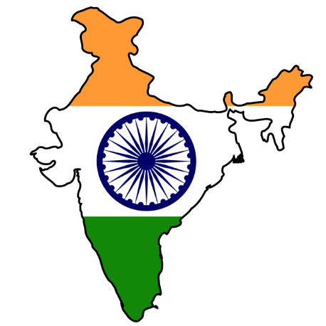
Prevent | Detect | Respond Select Highlights for 4 of 12 GHS Countries: 2014
Improved biosafety and biosecurity systems
Linked regional and national zoonotic disease networks
South Africa
Vietnam
Increased laboratory capacity to detect antimicrobial threats
_______________?
India
Kenya

Slide 36
Thanks
For more information please contact Centers for Disease Control and Prevention
1600 Clifton Road NE, Atlanta, GA 30333
Telephone: 1-800-CDC-INFO (232-4636)/TTY: 1-888-232-6348
Visit: www.cdc.gov | Contact CDC at: 1-800-CDC-INFO or www.cdc.gov/info
The findings and conclusions in this report are those of the authors and do not necessarily represent the official position of the Centers for Disease Control and Prevention.
National Center for Emerging and Zoonotic Infectious Diseases
Division Name in this space

