Slide 1
KENYAN EXPERIENCE IN BIOSAFETY/BIOSECURITY MANAGEMENT
By
K. K. Yatich (IFBA Certified Professional)
Head, Biosafety/Biosecurity Program
National Public Health Laboratories
Ministry of Health, Kenya

Slide 2
Outline
Biosafety /Biosecurity introduction
Public Health Security/Global threats/Efforts
NPHL-MOH Biosafety/Biosecurity Program
-Goals
-Achievements
-Challenges
- Strategies
- Way forward

Slide 3
Laboratory Biosafety /Biosecurity
Biosafety
How to protect health workers from dangerous pathogens
Biosecurity
How to protect dangerous pathogens from bad people
Laboratory biosafety is the basis on which to build laboratory biosecurity

Slide 4
Some Public Health Hecurity Scenarios/Issues of Concern
How ready are we to respond to viral haemorrhagic fevers e.g ebola?
Dangerous pathogens e.g anthrax, Brucella are cultured in our labs
these can be easily accessed and can fall into the wrong hands
Water supplies can be contaminated by easily accessible pathogens and cause widespread disease/death
Distribution of contaminated food with dangerous pathogens

Slide 5
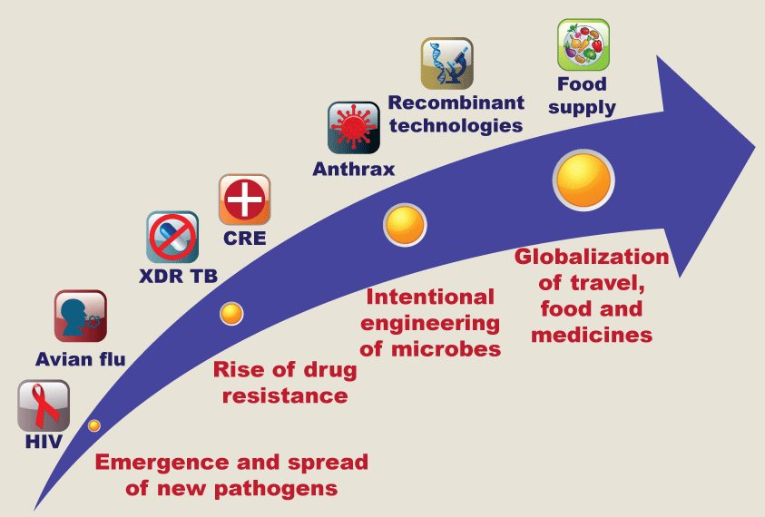
Perfect Storm of Vulnerability

Slide 6
Hence Global Security Efforts
Global Health Security Agenda (GHSA)
- an effort by nations, international organizations, and civil society to accelerate progress toward a world safe and secure from infectious disease threats
International Health Regulations (IHR,2005)
- aim to prevent, protect against, control and provide a public health response to the international spread of disease

Slide 7
NPHL’S (MOH) Biosafety & Biosecurity Program Goals
Strengthen laboratory Biosafety and Biosecurity systems at national and county levels
To undertake appropriate training and competence development programs to support Biorisk management at both levels of governments
Develop a processes and tools for implementing a Biorisk management systems

Slide 8
Program Goals cont..
Synchronized coordination of Biosafety and Biosecurity activities among all the implementing partners
Technical support to counties and implementing partners on biosafety/biosecurity at all levels.
Monitor and ensure adherence of Biosafety/Biosecurity standards and Practices
Regularly update relevant biosafety/Biosecurity policy guidelines

Slide 9
Key achievements
Biosafety/Biosecurity training curriculum developed
Training
- successfully coordinated the training of over 3000 laboratory Health Care Workers on laboratory Biosafety and Biosecurity at national and across counties.
- Over 100 Biosafety/Biosecurity TOTs trained
6 Biomedical technologists internationally trained on certification of Biosafety Cabinets locally.

Slide 10
Key achievements cont..
Supported ISO 15189 accreditation of medical laboratories
-130 labs enrolled
- 15 labs accredited
Procured and distributed autoclaves and other waste management equipment to facilities at National and County facilities
Improved Biosafety/Biosecurty practices in the medical laboratories through adherence to SOPS

Slide 11
Challenges
Weak Pathogen repository and inventory systems.
Weak Chemical management, inventory safety and disposal systems/guidelines
Training of other Cadres of Health Care Workers / personnel from Plant Health Sector, MALF and Wildlife.
Lack of an integrated Biorisk Management curriculum based on One Health approach

Slide 12
Challenges…
Inadequate funding to strengthen implementation of Biosafety/Biosecurity systems in medical laboratories
Lack of Biorisk management training in regions not currently covered by CDC-PEFPAR- funded partners
Lack of Biosafety/Biosecurity annual refresher
trainings

Slide 13
Strategies
Integration of BRM in FELTP Program
Establishment of MOH-EOC
WHO-Joint External Evaluation on implementation of IHR/GHSA Packages
Enactment of Bioscience Bill to address among others Dual use & Bioethics
Strengthen collaboration between Health Sector & Law enforcement/Security agencies

Slide 14
Way forward
Establish an updated inventory of potentially dangerous pathogens in restricted facilities and license, monitor, track highly toxic biological materials - GHSA
Develop whole-of-government specific Biosecurity legislation and strategic plan
Design a comprehensive, sustainable and legally embedded national oversight program for Biosafety and Biosecurity draft Bioscience Bill
Develop whole-of-government integrated Biorisk curriculum and subsequent Biorisk trainings on basis of one-Health Approach

Slide 15
Way forward cont..
Strengthen laboratory Biosafety and Biosecurity systems including physical infrastructure of labs at national and county levels through sustained funding.
Capacity building on standard BSL3 safety practices and Biorisk management trainings for the new laboratories at NPHL and counties through exchange and mentorships programs

Slide 16
Acknowledgement (Collaborating Partners)
AMREF – Coast/Lower Eastern
UMB – Nairobi/Central/Upper Eastern
GIS – Nyanza/Western
FHI360 – Rift Valley
APHIA Plus
FACES
AMPATH
CHS
KCCB
HEALTHSTRAT
CDC (PEPFAR)
DTRA/CBEP
AFENET
PATH
MSH
KEMRI
NACOSTI

Slide 17
Thank You

