Slide 1
Assessment of Rational Use of Antimicrobials in Pediatric Ward at Nanyuki Referral Hospital in Laikipia County, July 2017–June 2018
Edna Kubai
Laikipia County

Slide 2
INTRODUCTION
Rational use of antimicrobials
-Patients receive medications appropriate to their clinical needs,
-Appropriate doses
-Adequate period of time and at lowest cost
Antibiotics use is routine practice for the treatment of pediatrics

Slide 3
Problem Statement
Globally within 2000 to 2015 in 76 countries, there was 65% increase in antibiotic consumption at 21.1 billion - 34.8 billion Defined Daily Doses
(Klein E et al,2018)
Africa
-Ethiopia -86.6% of antibiotics used inappropriately children <5 years (A.Tekleab et al ,2017)
Kenya
- Kenyatta hospital neonatal unit , 73% prolonged antibiotic use
- 42% unjustified antibiotics use while (R.Musoke,2000)
-Intensive care unit only 26 % appropriately used (Z.Ngumi,2006)
-4 out of 10 public hospitals prescribe according to guidelines (MOH,2009)

Slide 4
Justification
Prescribing practices not studied extensively in Kenya
- Limited data on the extent of irrational prescribing
No drug prescribing study has been conducted in Nanyuki County Referral Hospital
Hospital not included in the national survey on assessment of the pharmaceutical situation in Kenya
Study findings will provide information on rational drug prescribing practices
inform extent of implementation of antimicrobial use guidelines
Inform in the hospital essential medicines procurement

Slide 5
Objectives
General objectives
To assess the rational antimicrobial use in pediatric ward at Nanyuki referral hospital
Specific objectives:
Describe the indications for prescription of antimicrobials
Determine the commonly prescribed classes and mode of administration of antimicrobials
Describe rational antimicrobial use
Data Quality Audit

Slide 6
Study site
NTRH, Laikipia East sub county, Laikipia County, Kenya
A level 5 health facility
210 inpatient bed capacity
Pediatric ward bed capacity 47

Slide 7
Study design
Period under review: July 2017-June 2018
Study design: Cross sectional study done through retrospective reviewing of medical in- patients files at pediatric ward
Case definition: any medical case patient, at pediatric ward in Nanyuki Referral Hospital during the period of July 2017-June 2018
Exclusion of any surgical file or incomplete file and outpatient cases

Slide 8
VARIABLES
Age | Medical tests
Weight | Empirical test or definitive test
Area of residence | Antimicrobial test ; oral, IV
Comorbidities | Rational or irrational prescribing
Diagnosis | Prescriber
 | Generic or brand name

Slide 9
Methodology
Extraction of data from the files and entered to physical data collection tool
Rationality determined by analyzing whether prescribing followed the guidelines as per diagnosis made
Reference guidelines;
Ministry of Health –Basic pediatric protocol and
WHO Pediatric protocol
ta analyzed by MS .Excel , Epi -info
Principle outcome of interest ; rational or irrational prescribing
Data analysed ;MS-Excel , Epi-Info

Slide 10
Definition of terms
The rational use of antimicrobials is
-patients receive medications appropriate to their clinical needs
-In accordance to the set clinical guidelines
-at the lowest cost
Antimicrobial agents are different classes of molecules that ;
-suppress multiplication ,growth or kill microorganism bacteria ,fungi and viruses

Slide 11
Results

Slide 12
Results
Records Reviewed- 678 irrational prescribing at 20.51% (n=138)
The median weight 9.05kgs ,range (1.1- 38)
Diagnosis with the leading irrational prescription
-Acute gastroenteritis 8.11%(n=55)
-Viral URTI 3.83 %(n=26) and Poisoning 2.36%(n=16)
The highest comorbidity severe malnutrition 5.46%(n=37)
The median antimicrobial per prescription 3 range (0-8)
First line 66.81%(n=453) ,Switch to second line therapy 13%(n=90) immediate introduction to second line therapy,19.94%(n=135)

Slide 13
Social demographic characteristics of pediatrics admitted in NTRH ,July 2017-June 2018
Variable | Frequency (n=678) | Proportion
Sex Male Female | 406 272 | 59.91 40.09
Age group < 1year 1 year-5 years >5years | 264 359 55 | 38.94 52.95 8.11
Residence Thingithu Nanyuki Meru Central Nyeri Central Others | 161 161 134 49 173 | 24.03 24.03 20 7.31 25.52

Slide 14
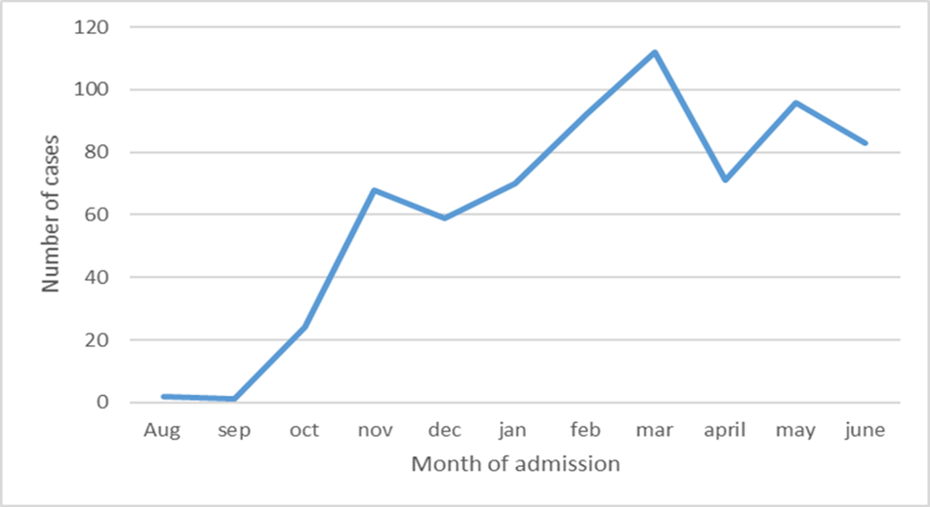
Case against admission time by month ,NTRH July 2017-June 2018

Slide 15
Causes of admission <15 years pediatric ward-NTRH,July 2017-June 2018

Slide 16
Clinical characteristics for pediatrics NTRH-Pediatric Ward,July 2017-June 2018
Variable | Frequency | proportion
Laboratory test Full Haemogram(FHG) Urea,Electrolyes,Creatinine Liver Function Tests (LFTs) CSF analysis Culture sensitivity | 539 415 74 28 6 | 79.58 61.28 10.91 4.13 0.88
Prescriber (n=678) Medical Officer Intern(MOI) Clinical officer intern (COI) Medical officer (MO) Pediatrician | 407 139 76 56 | 60.3 20.5 10.91 8.26

Slide 17
Proportion of antimicrobial administered,Pediatrics Ward -NTRH,July 2017-June 2018 (1/2)
Antimicrobial (n=1178)
Admission (Intravenous) | Frequency | Admission (Per Oral) | Frequency
IV. Penicillin | 23.8% | P.O. Penicillin | 4.3%
IV.Aminoglycoside -Gentamycin | 22.9% | P.O. Metronidazole | 0.9%
IV cephalosporin | 12.6% | P.O.Macrolide | 0.6%
Iv Aminoglycoside -Amikacin | 4.5% | P.O Fluoroquinolone | 0.2%
IV Metronidazole | 0.7% | Others | 0.7%
Others | 0.1%

Slide 18
Rational antimicrobial use by cadre of prescriber in pediatric ward –NTRH ,July 2017-June 2018
Prescriber | Rational | Irrational
Medical Officer Intern(MOI) | 308(45.38%) | 95(14.01%)
Clinical Officer Intern(COI) | 58 (8.55%) | 16(2.36%)
Medical Officer (MO) | 115(16.96%) | 22(3.24%)
Pediatrician | 51(7.52%) | 5(0.74%)

Slide 19
Rational Antimicrobial Use By Age Group,Pediatric Ward –NTRH , July 2017-June 2018
Age group ( n=670) | Rational prescribing | Irrational prescribing
<1year | 224(32.89%) | 40(5.90%)
1year-5 years | 272(39.68%) | 87(12.83%)
> 5years | 44(6.34%) | 11(1.62%)

Slide 20
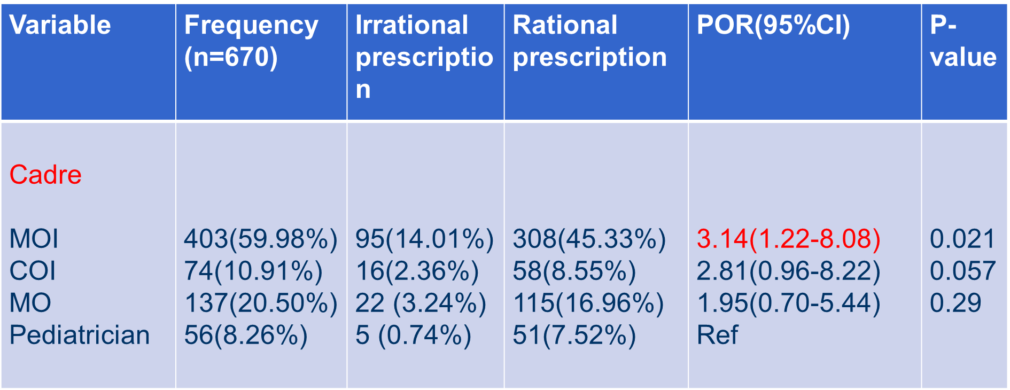
Association with irrational antimicrobial use at pediatric ward –NTRH, July 2017-June 2018

Slide 21
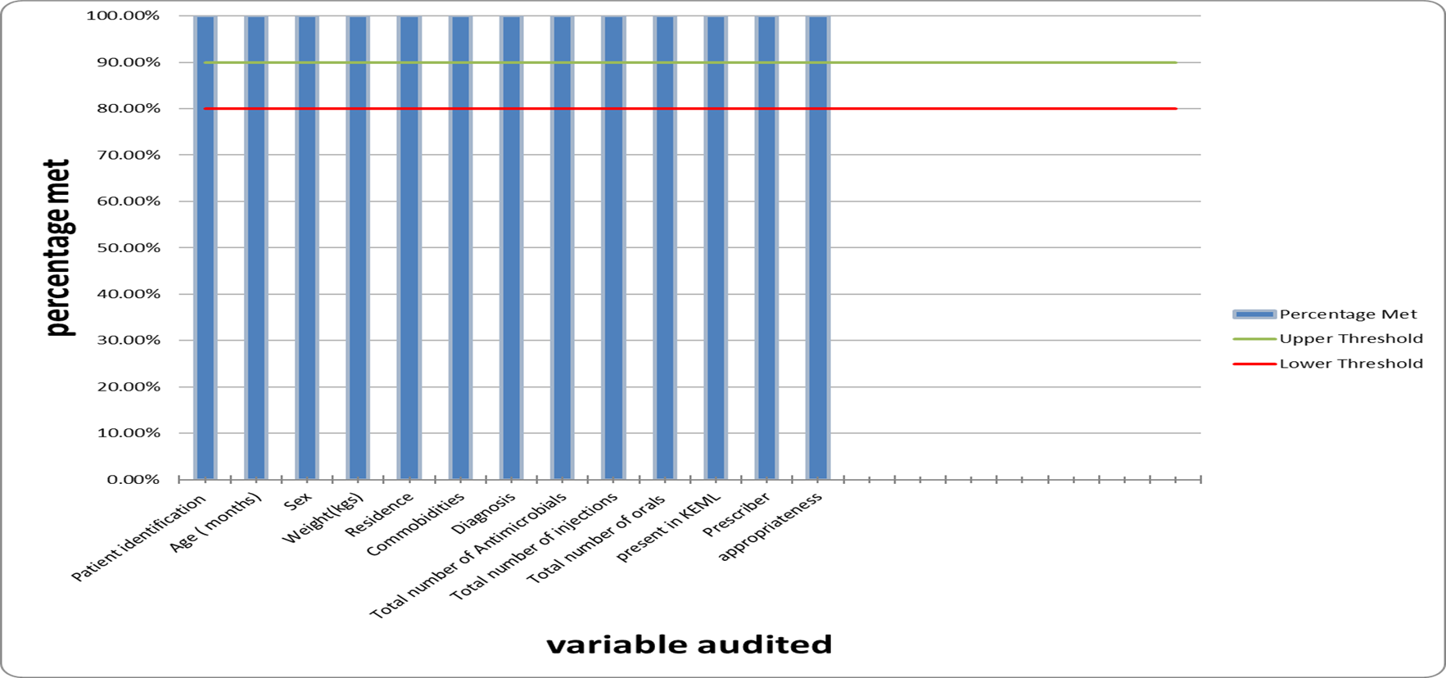
Data Quality Audit Results of paediatrics inpatient files in NTRH between july2017-June 2018

Slide 22
Discussion 1/3
From the area of study ,relatively rise in irrational prescribing of antimicrobials
Infections treated irrationally ; acute gastroenteritis , viral respiratory infection, asthma and poisoning
-Irrational prescribing explained by limited number specialists, lack of use of pediatric management guidelines, less experienced prescribers
-Similarly, Addis Ababa 86.6% of pediatric patient managed diahorrhea and cough irrationally

Slide 23
Discussion 2/3
Most patients had more than 3 antimicrobials ;degree of poly-pharmacy
-Likelihood cause is lack of training to new prescribers as well as refresher for experienced prescribers, empirical treatment or symptomatic treatment
-Similarity with Eastern Ethiopia 2.34 , India 2.7 and Nigeria3.7 all significantly higher to the WHO recommendation of 1.6 -1.8

Slide 24
Discussion 3/3
The MOI had three times odds of irrational prescribing compared to specialist
Possible reasons :
-inexperience since still on training
-the younger prescribers fear of “not treating bacteria infection”
- lack of laboratory utilization for definitive diagnosis
- patient and parental pressure
-Influence from the pharmaceutical companies

Slide 25
Limitations
The study did not cover Out –Patient department, Mother Child Health (MCH) clinic ,surgical cases
The study did not include drivers of in appropriate prescribing such as prescribers knowledge ,prescriber attitude , drug availability, laboratory diagonistic awareness and influence from medical representatives
The missing patient files and files missing information
Lack of the antibiotic summary register at the facility

Slide 26
Conclusion
Pneumonia, acute gastroenteritis, bronchiolitis leading cause of hospitalization
Polypharmacy with at least 3 antimicrobials per encounter
Commonly prescribed
-On admission IV aminoglycoside –gentamycin ,IV penicillin
-Upon discharge, Oral penicillin were commonly prescribed
Irrationally managed infections were acute gastroenteritis and viral respiratory infections
The MOI had three times odd of irrational prescribing
Lack of antibiotic register and Inconsistent data reporting

Slide 27
Recommendation
The MOI ,COI on training should practice under supervision
Induction ,orientation and training on guidelines should be given to new prescribers
Advocacy of IPC practices to assist in the decline of HAIs
Continuous Medical Training(CME ) and refresher training should be implemented
Culture sensitivity test should be embraced for Definitive management
Research done on driving forces of prescribing
Research to be performed in other departments that deal with pediatrics ;outpatient department, Mother –child health clinic

Slide 28
Public Health Action
The Hospital therapeutic committee held a meeting made the following resolution
-Recall all the watch and reserved class of antibiotics from tier 1 and 2 facilities
-started preparing a standard operating procedure (sop) for prescribing antibiotics
-Prescribers should prescribe molecules within the hospital drug formulary and MOH Essential list
-Popularize the request of Culture and sensitivity before initiating antibiotics especially on recurring and resistance infections as well as strengthening the laboratory capacity

Slide 29
Acknowledgement
Clinton Health Access Initiative (CHAI)
Kenya Field Epidemiology &Laboratory Training Program (KFELTP)
Nanyuki Teaching & Referral Hospital staff

Slide 30
References
H.Gelband “Policiesto address antibiotic resistance in low income countries National and International Action on antibiotic resistance
Klein EY, Van Boeckel TP, Martinez EM, et al. Global increase and geographic convergence in antibiotic consumption between 2000 and 2015. Proc Natl Acad Sci U S A. 2018;115(15):E3463-E3470. doi:10.1073/pnas.1717295115
Y.Asfaw et al ‘Antibiotic prescribing practice management of cough or diahorrhea among children attending a hospital in Adis Ababa:a crosss section study
Republic of Kenya :’Assessment of Pharmaceutical situation in Kenya
R.Musoke ,”Emmergence of multidrug –resistant gram negative at KNH in neonatal unit and the therapeutic implications
Z.W.W “Nosocomial infections at KNH intensive care unit in Nairobi Kenya

Slide 31
Thank you

