Slide 1
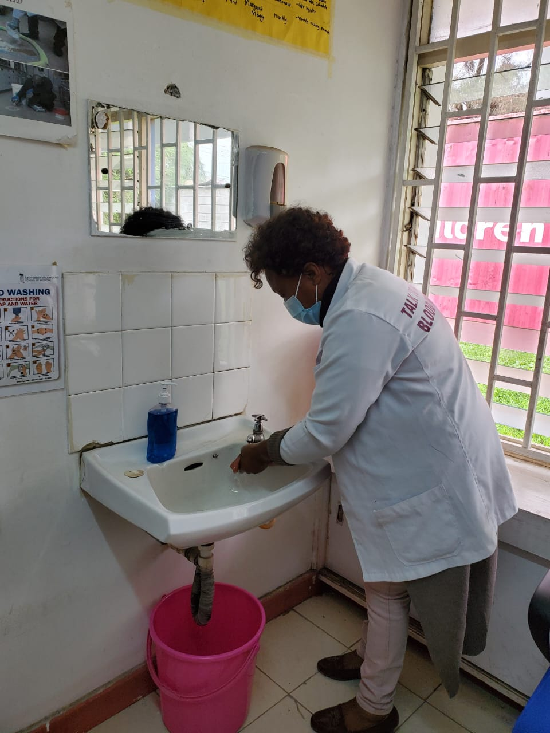

Slide 2
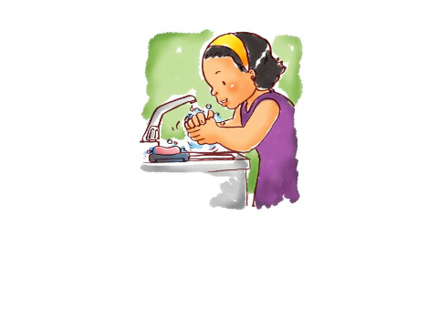
COMPLIANCE OF HAND HYGIENE PRACTICES AMONG HEALTHCARE WORKERS AT UMOJA 1 HEALTH CENTRE, IN NAIROBI CITY, KENYA.

Slide 3
Authors
Simon Mong’are, Umoja 1 Health Centre, IPC-Focal Person (simonondarah94@gmail.com) |  | Joshua Orawo, CIHEB-Kenya, (JOrawo@cihebkenya.org)
Esther Sankale, RCN/BScPH, Sub-County QI Coordinator Embakasi West. branicesan@gmail.com IPC MENTOR |  | Dr. Rebecca Wangusi, Program Director CIHEB-Kenya, Connect Program, Nairobi County (Rwangusi@cihebkenya.org)

Slide 4
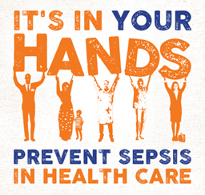
outline
Introduction
Methods
result
Conclusion
‘
Lack of Hand Hygiene + Patient Care = Increased Risks

Slide 5
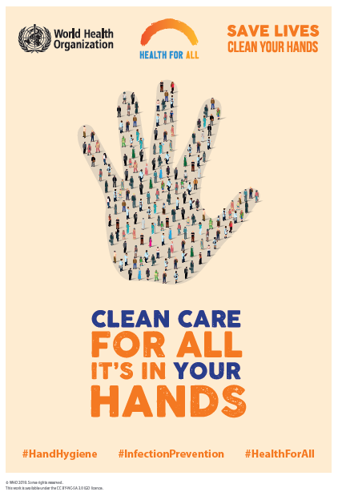
Introduction
Hand hygiene is a simple and low-cost measure known prevent 50% of avoidable infections in healthcare settings, and only 9% of HCWs in low-income countries and 70% in high-income countries comply with hand washing (WHO,2020).

Slide 6
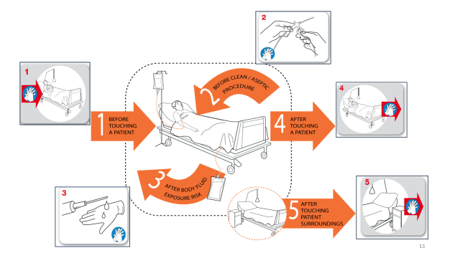
Your 5-Moments For Hand Hygiene
Effective HH is in our HANDS

Slide 7
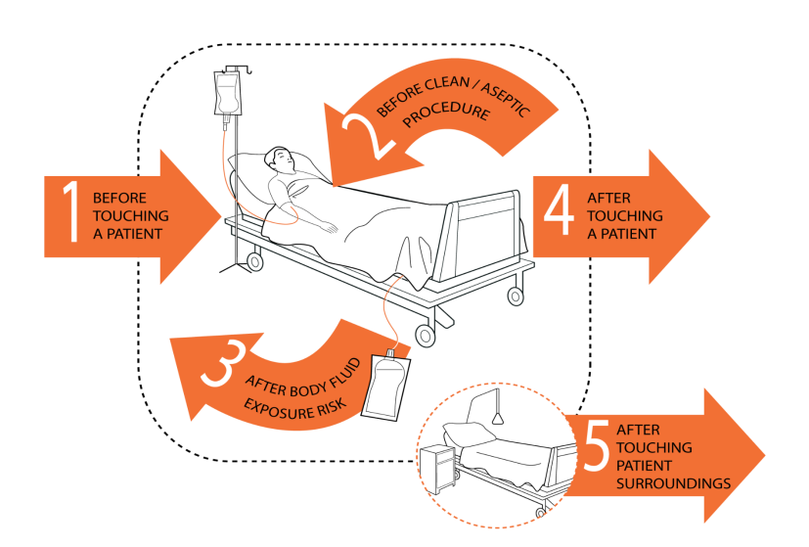
Methodology
Cross-sectional study was conducted among 69 HCWs from July to December 2022. WHO hand hygiene audit tool was used to assess the five critical moments (before and after touching a patient, before aseptic procedure, after body fluid exposure, and after touching patient’s surroundings).
The data collected was stored in the infection prevention control (IPC) file and analyzed using descriptive statistics in Microsoft Excel.

Slide 8
Results
All the 69 Health Care Workers from different cadres were observed during the study period, 58 (84%) were females.
The participant’s age ranged between 30-45 years.
Overall, 5 HCWs (7%) were compliant in all the five critical moments.
By cadres and departments 2 (8%) clinicians in OPD, 1 (6%) clinician in CCC and 2 (8%) nurses in MCH were compliant.
Specifically, 5 (7%) of HCWs adhered to hygiene before touching a patient, 8 (12%) before any aseptic procedure, 11 (16%) after body fluid exposure, 28 (40%) after touching a patient, and 17 (24%) after touching a patient’s surroundings.
.

Slide 9
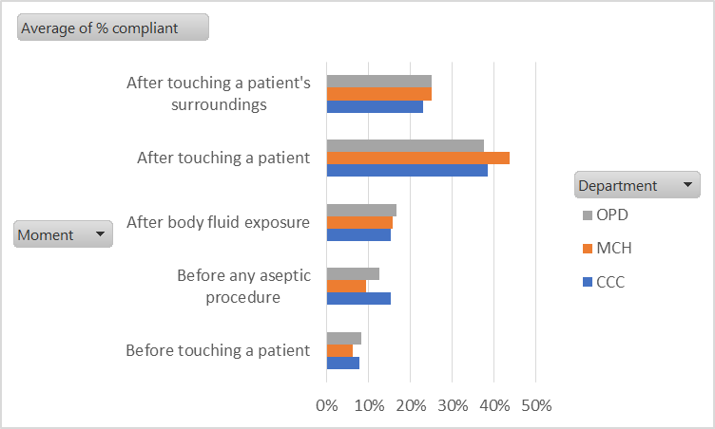
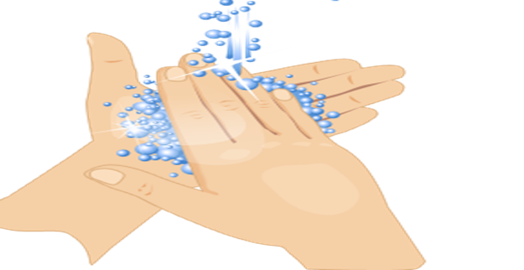
Result

Slide 10
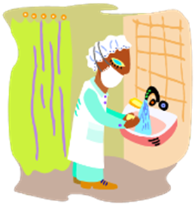
recommendations
Active Feedback- Coaching, Voice expectation to all staff, Engage staff, Frequent communication, Celebrate improvement
No One is Excused- Protect the patients, Hold everyone accountable, Commitment, Role modeling, Apply progressive discipline from the top
Data Driven
HH monitoring Culture- Regular hand hygiene audits to enhance compliance

Slide 11
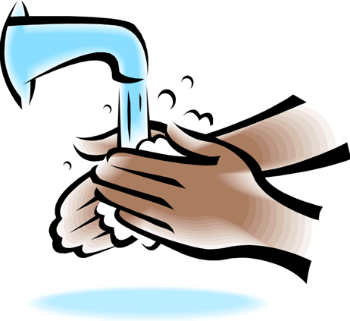
Conclusion
Overall, hand hygiene compliance was 7%. There is need to implement routine hand hygiene audits that will guide on measures to improve compliance and reduce transmitting infections to patient.
An integration of theories and models for designing of interventions is recommended to increase adherence to hand hygiene behavior.

Slide 12
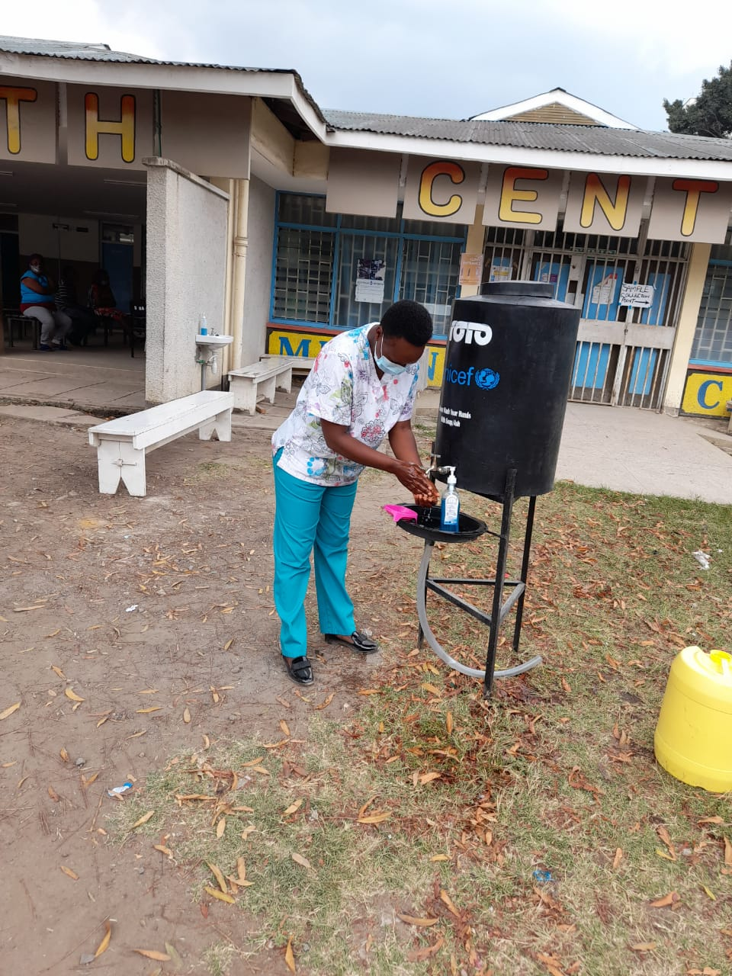
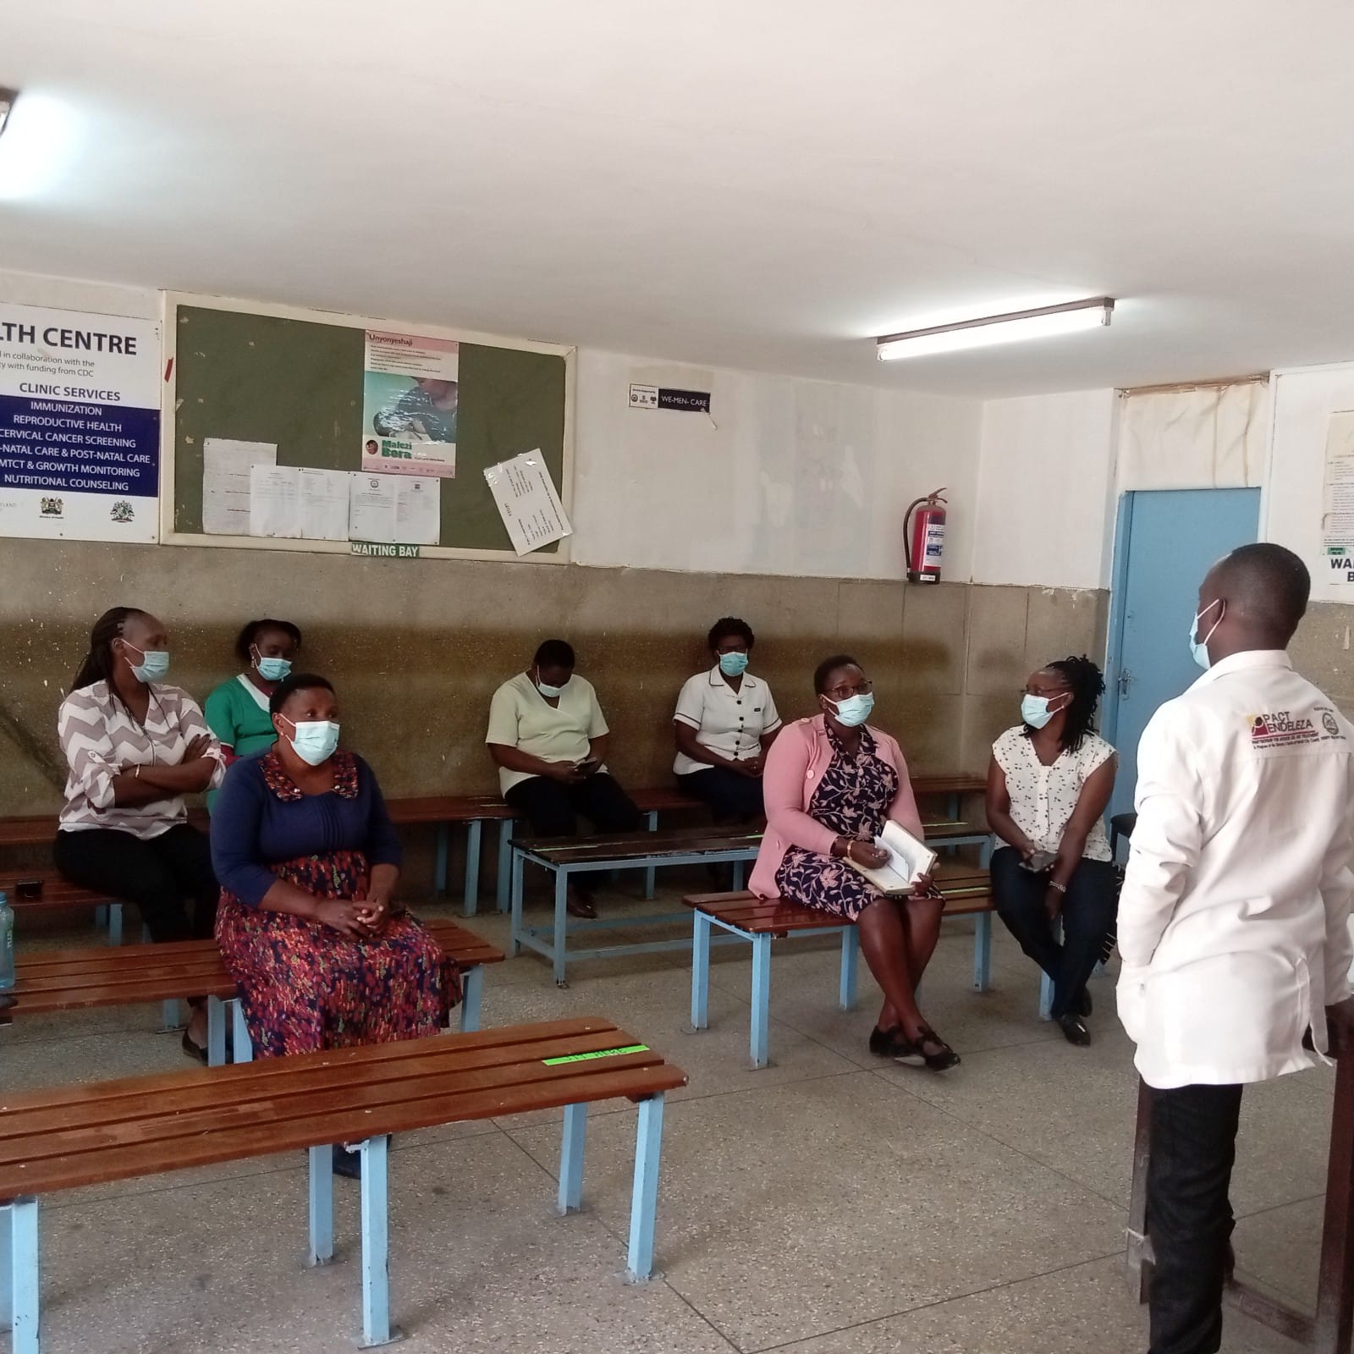
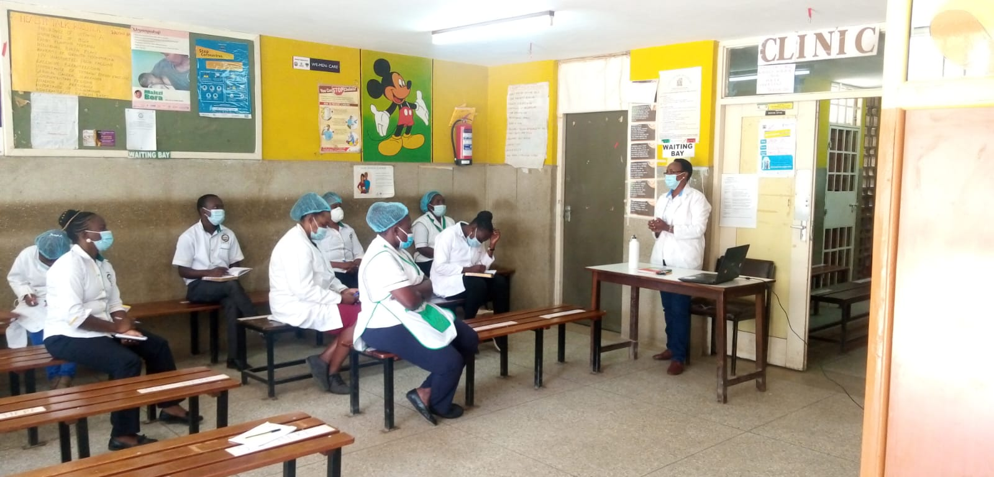
Evidence-based interventions
IPC committee meeting
CME Session

Slide 13
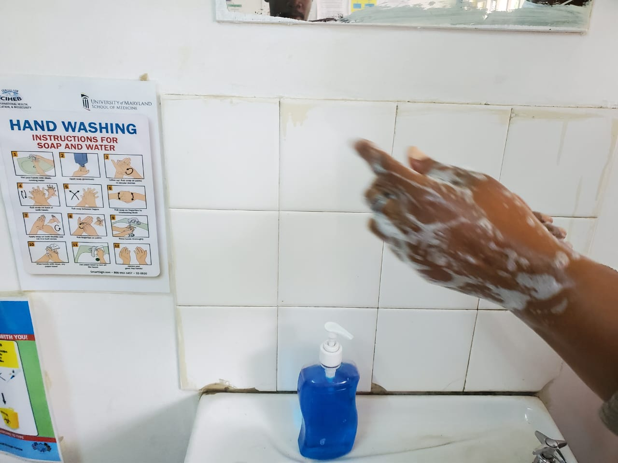
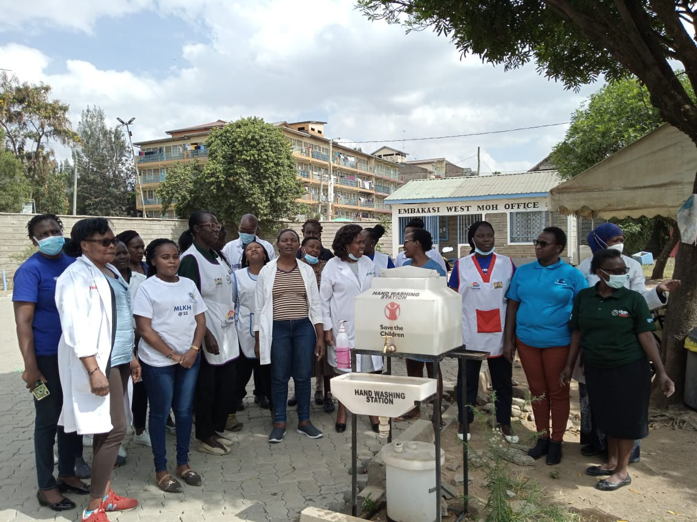
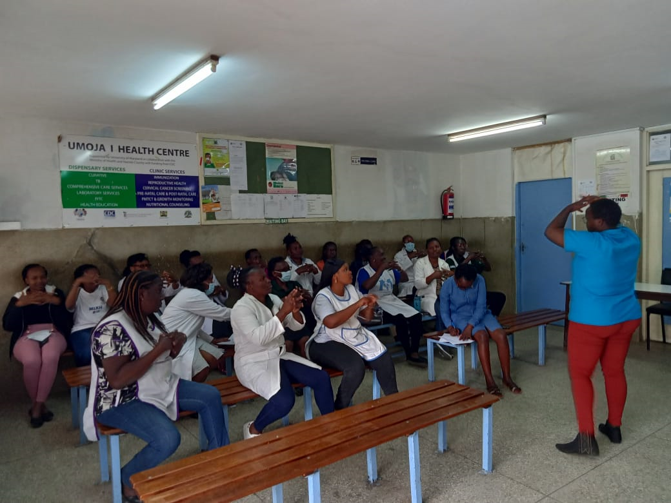
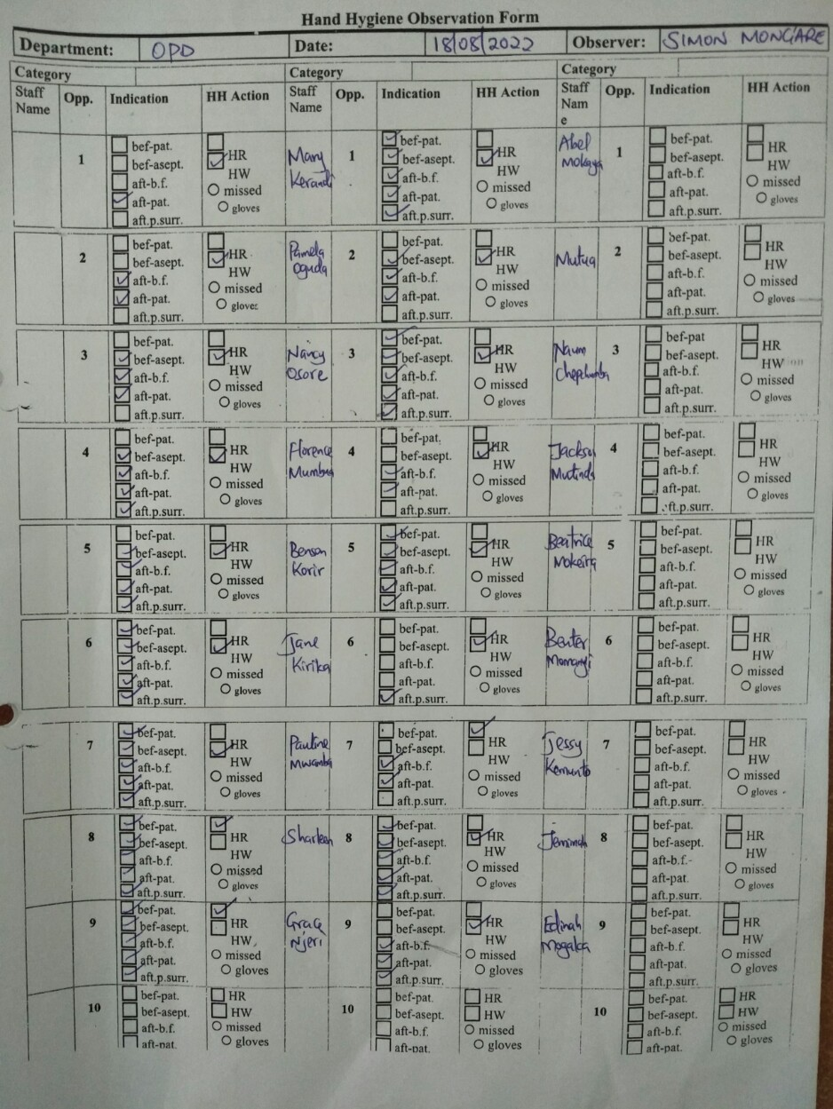
Evidence-based interventions
CME on hand washing
WHO HH Tool

