Slide 1

Electronic Surveillance of Carbapenem-Resistant Organisms in the ICU: A Retrospective Analysis from a Tertiary University Hospital
David Odada, Infection Preventionist, CIC
Aga Khan University Hospital Nairobi

Slide 2
Introduction
Multidrug resistant organisms (MDROs), a major global health threat
Healthcare MDROs burden estimates, 15-20% in LMICs vs. 5-10%, high-income nations
ICUs, carry the most burden, antimicrobial resistance rates are 40% more than general wards
Clinical microbiology labs play critical role supporting MDROs surveillance
Notes:
Economic burden, negative impact on patient morbidity and mortality

Slide 3
Literature Review
AUTHOR AND YEAR OF STUDY | STUDY DESIGN | OBJECTIVES | RESULTS
Mitgang, E. A., et al. (2018) | A Systematic Review | To construct a database and maps of available, data on the presence and distribution of carbapenem-resistant E. coli and Klebsiella in the WHO Africa Region. | The study analyzed 314 reports across 31 African nations, with south Africa (24%) and Nigeria (19%) contributing the most data. Kenya accounted 7% of total reports. 10 studies from Kenya met inclusion criteria but 4 originated from a single institution, suggesting potential geographical bias and limited nationwide representation. Kenya reported carbapenem-resistant E. Coli and Klebsiella, with crude median resistance estimates, E. Coli: 1-5% and Klebsiella: 0-1%. This likely underrepresent ICU-specific prevalence
Saharman, Y. R., et al. (2021). | Scoping review | To present the data published on ICU-acquired infections and on antimicrobial resistance in ICUs in LMICs between 2005 and 2018). | 51 records included after full review. A small percentage (22%) of LMICs had publishable ICU infection data. A. baumannii (24%), P. Aeruginosa (16%), and K. Pneumoniae (15%) accounted for >50% of ICU MDR infections. ICU Mortality (33.6%) was double compared to Europe.

Slide 4
Literature Review
AUTHOR AND YEAR OF STUDY | STUDY DESIGN | OBJECTIVES | RESULTS
Schaumburg, T., et al. (2023). | A case study | compared the data derived via manual chart review to that which was derived from electronic routine data. | The high agreement rates for MDRO detection (75%) and bacteremia classification (85%) demonstrate the reliability of the algorithm, as its outputs were consistent with manual chart review in identifying resistant pathogens and classifying bloodstream infections as ICU-acquired.
Reilly, J. S., et al. (2015). | A case study | Reviews describes the Scottish experience establishing automation of ICU surveillance of HCAI and outlines the critical components of successful integrated surveillance in clinical care. | Automated surveillance improves HAI detection patterns faster and more accurately by in-cooperating real-time alerts and trend monitoring. It enables linking trends with patient factors, device use, hospital days, patient location and informs targeted prevention strategies
Maina, J. W., et al. (2024). | Cross-sectional study | Assessed the prevalence of CR-GNB infections and risk factors for acquisition in a Kenyan ICU | Included 162 patients clinically presenting with bacterial infection after 48 h of ICU admission. CR-GNB infections prevalence was 25.9% (42/162), with Klebsiella pneumoniae (35.7%, 15/42) and Pseudomonas aeruginosa (26.2%, 11/42) predominating. All isolates were multidrug-resistant (MDR). P. aeruginosa and A. baumannii were 100% colistin-resistant, while K. pneumoniae (33.3%) was tigecycline-resistant.Patients with prior antibiotic use were 3×higher odds of developing CR-GNB infections (p-0.005)
Notes:
Available, relevant and useful data on the presence and distribution of carbapenem-resistant E. coli and Klebsiella in the WHO Africa Region.

Slide 5
Justification
  WHO established a priority list of microorganisms (ESKAPE group of pathogens) to inform research priorities for the development of new antibiotics
  In Africa, only 1/3 of healthcare transmission of MDRO identify the source
  Surveillance challenges hinder timely response (Human resource, diagnostics, Manual surveillance)
  Under utilised surveillance registry limits baseline infection data estimates
  Automated surveillance enhances early detection of MDRO and intervention

Slide 6
Study Objectives
Determine the prevalence of carbapenem-resistant bacterial using automated surveillance in intensive care unit at Aga Khan University Hospital
Demonstrate automated surveillance of carbapenem resistant bacterial clusters detection system in ICU at Aga Khan University Hospital
Notes:
The baseline level of MDRO control activities designed to ensure recognition of MDROs as a problem.

Slide 7
Methods
A retrospective observational study design reviewing automated surveillance process for carbapenem resistant organisms
Study Location: Aga Khan University Hospital, Nairobi – 300-bed 11 ICU rooms, and Meditech EHR used by >5,000 users
Study Population: ICU microbiology isolate reports (Jan 2023 – Dec 2024) and EHR ICU patient database
Inclusion Criteria: Carbapenem-resistant organisms from patient admitted in ICU for >2 days during the study period (E.coli, K.pneumo, P. Auriginosa, and A. Baumannii
Ethical Consideration:
  Aga Khan University Hospital, Nairobi Institutional Scientific and Ethics Review Committee (ISERC) (2025/ISERC-071 (v2).
  Approval by the National Commission of Science, Technology, and Innovation (NACOSTI), (NACOSTI/P/25/4176423).

Slide 8
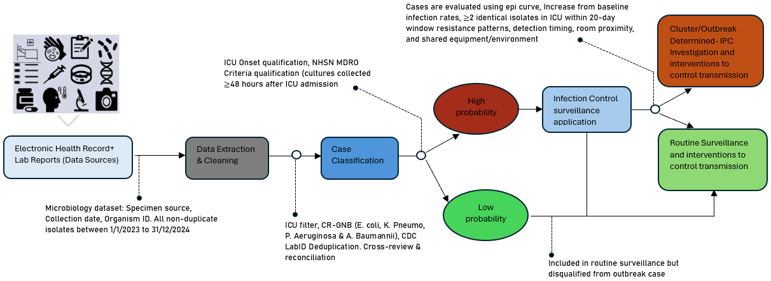
Methods
Flow of data in automated surveillance for MDRO and clusters detection

Slide 9
Results
Hospital and community onset MDROs

Slide 10
Results- Resistant pathogens
Distribution and trends of carbapenem-resistant organisms across the two years

Slide 11
Results
Overall all specimen prevalence of 22% of carbapenem resistant isolates. Proportion of carbapenem resistant pathogen for all specimen, E. coli, K. pneumo, A. aeruginosa, and A. Baumannii

Slide 12
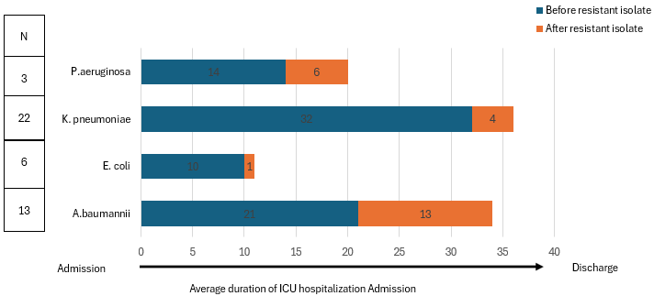
Results-Impact on hospitalization

Slide 13
Results- Infection Clusters
Temporal clustering of carbapenem-resistant pathogens, with certain months showing peaks above the outbreak threshold (black line), acting as a trigger investigations for potential healthcare transmissions

Slide 14
Discussion
K. pneumoniae and A. baumannii were the frequently isolated pathogens and an MDRO prevalence of 22%, consistent with global ICU resistance trends and a local study by Maina, J. W., et al which reported a prevalence of 25.9%.
Similar to a multicenter study, resistant organisms is associated with increased hospitalization, with additional days accrued after culture positivity, Pipitò, L., et al.
While our study suggests significant endemic pressure for A. baumannii, it differed with a study by Magobo, R. E., et al. that showed acute epidemic spread for resistant pathogens
Clusters of carbapenem-resistant pathogens (notably K. pneumoniae and A. baumannii) were observed above the outbreak threshold guiding investigations and reinforcement of IPC interventions

Slide 15
Conclusion
High rates in CRE and A. baumannii pose major challenges in controlling hospital transmissions
Electronic surveillance facilitates real-time MDRO detection, cutting down response time significantly.
Targeted surveillance through coupling culture positivity monitoring with resistance profiling is key in generating actionable insights for infection prevention and antimicrobial stewardship.

Slide 16
References
1. Mitgang EA, Hartley DM, Malchione MD, Koch M, Goodman JL. Review and mapping of carbapenem-resistant Enterobacteriaceae in Africa: Using diverse data to inform surveillance gaps. Int J Antimicrob Agents. 2018;52(3):372-84.
2. Saharman YR, Karuniawati A, Severin JA, Verbrugh HA. Infections and antimicrobial resistance in intensive care units in lower-middle income countries: a scoping review. Antimicrobial Resistance & Infection Control. 2021;10(1):22.
3. Maina JW, Mutua JM, Musyoki AM. Carbapenem-resistant gram-negative bacterial infections and risk factors for acquisition in a Kenyan intensive care unit. BMC Infectious Diseases. 2024;24(1):522.
4. Gu GY, Chen M, Pan JC, Xiong XL. Risk of multi-drug-resistant organism acquisition from prior bed occupants in the intensive care unit: a meta-analysis. J Hosp Infect. 2023;139:44-55.
5. Reilly JS, McCoubrey J, Cole S, Khan A, Cook B. Integrating intensive care unit (ICU) surveillance into an ICU clinical care electronic system. Journal of Hospital Infection. 2015;89(4):271-5.
6. Schaumburg T, Köhler N, Breitenstein Y, Kolbe-Busch S, Hasenclever D, Chaberny IF. ICU infection surveillance can be based on electronic routine data: results of a case study. BMC Infect Dis. 2023;23(1):126.
7. Pipitò, L., et al. (2025). "Outcome of Bloodstream Infections Caused by Antibiotic-Resistant Bacteria: A 7-Year Retrospective Study at the University Hospital of Palermo, Italy." Antibiotics 14(5): 464.
8. Magobo, R. E., et al. (2023). "Outbreak of NDM-1- and OXA-181-Producing Klebsiella pneumoniae Bloodstream Infections in a Neonatal Unit, South Africa." Emerg Infect Dis 29(8): 1531-1539.

Slide 17
Acknowledgements
Core Authors
  Prof. Reena Shah
  Prof. Gunturu Revathi
  Dr Jasmit Shah
  Miss Anastasia Mbithi
  Miss Hellen Munyi
  Dr Ibrahim Farah
IPNET
AKUHN

